Slide 1
T&D and Deep Mid-Century Decarbonization in New England
Presented To:
  Raab Restructuring Roundtable
Presented By:
  Jurgen Weiss
    March 13, 2020

Slide 2
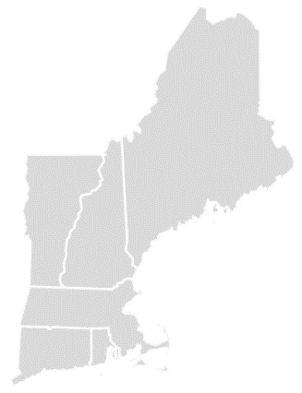




All New England States have 2050 deep decarbonization goals – three primary ways to get it done
Maine (Goal)
80% below 1990 level by 2050
Expand Energy Efficiency
Vermont (Goal)
80–95% below 1990 level by 2050
New Hampshire
(Recommended Goal)
80% below 1990 level by 2050
Electrify Transportation and Buildings
(Direct/Indirect)
Massachusetts (Limit)
80% below 1990 level by 2050
Connecticut (Limit)
80% below 2001 level by 2050
Rhode Island (Goal)
80% below 1990 level by 2050
Green Electric Sector

Slide 3
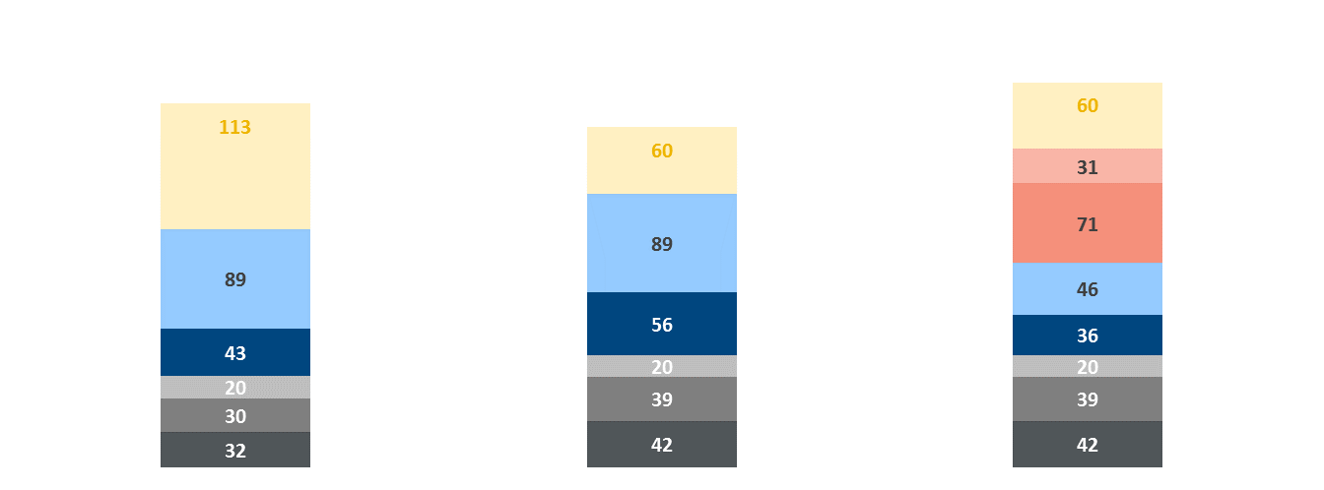
EE+Electrification = Electricity demand in New England will likely roughly double by 2050
2050 New England Annual Electricity Demand (TWh)
Efficiency Focused
Electrification Focused
Electrification and
Renewable Fuels
Scenario:
Relative to 2018:
+77%
+103%
+136%
+40 TWh
Electricity Savings
from Res & Com EE
Indirect Electrification*
via Renewable Fuels
Transport
Res & Com
-32 TWh
Transport
Direct Electrification
Res & Com
Industrial
Base
Commercial
Residential
Building Energy Efficiency | 1.5%/year | 0.7%/year | 0.7%/year
Building Electrification | All fuels: 80% Direct | All fuels: 95% Direct | Natural Gas: 50% Direct, 50% Indirect Other Fuels: 95% Direct
LDV/MDV Electrification | 90%/80% | 90%/80% | 90%/80%
HDV Electrification | 80% | 80% | 100% Indirect
Clean Electricity Generation | 95% | 95% | 100%

Slide 4
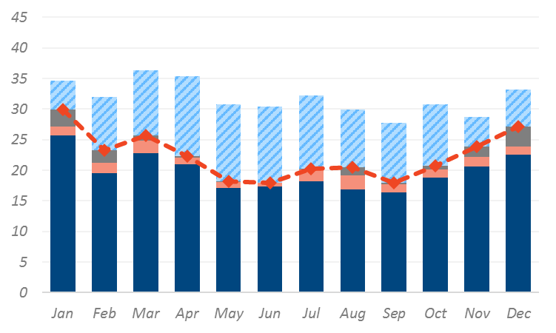
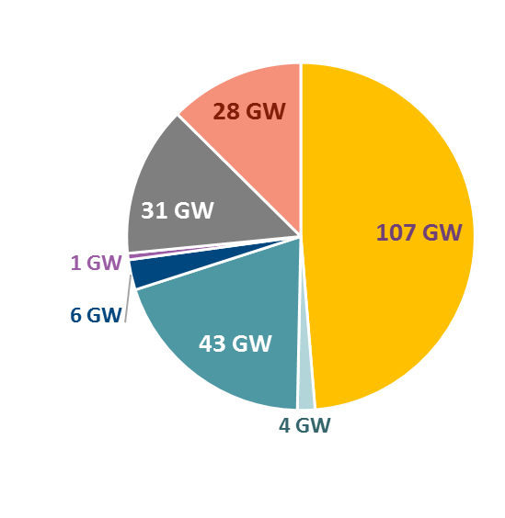
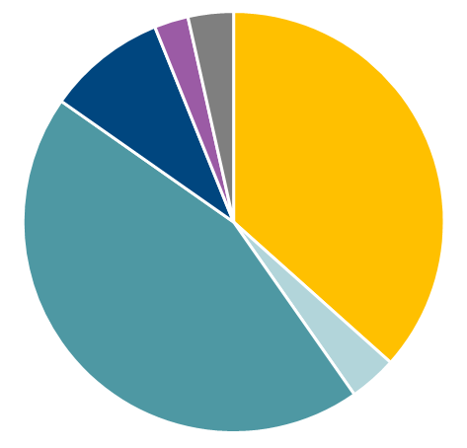
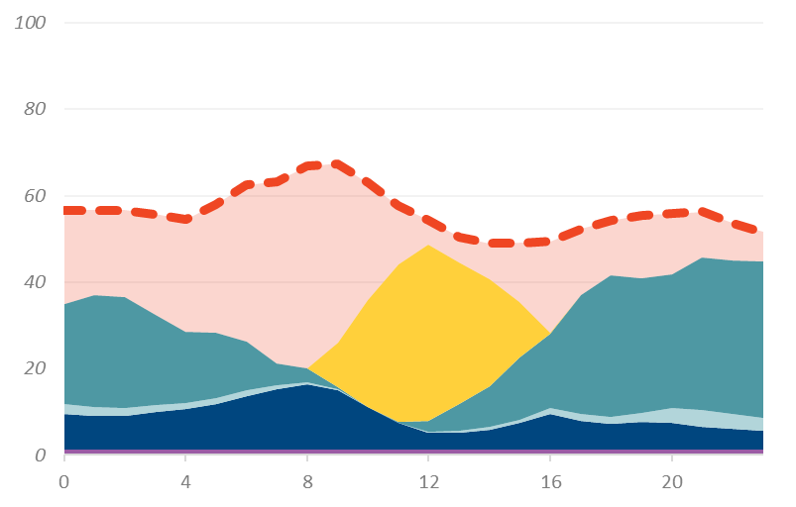
Higher load, lower clean capacity factors and curtailments mean a total capacity need of >200 GW
One of several possible New England Resource Portfolios
TWh
Monthly Supply
Installed Capacity
Total = 219 GW
Annual Generation
Total = 382 TWh
Storage
10 TWh; 3%
13 TWh; 3%
Load
35 TWh
9%
Curtailments
(27% of RE gen)
Gas
Solar
Gas
140 TWh
37%
Storage
Nuclear
Offshore Wind
170 TWh
44%
Clean Energy
Hydro
14 TWh
4%
Onshore Wind
Note: Load includes T&D losses. Curtailments include battery losses.
  OSW/large scale solar each 10% of technical potential
  Large scale solar 7.5% of non-forested land area
  28 GW of storage primarily needed to shift excess solar generation to peak load hours
  30 GW of “gas” generation to provide seasonal flexibility – about 3% of generation. Could be renewable gas such as bio-methane or P2G
  Other portfolios possible – but unlikely to change overall conclusion materially
Typical Winter Day
Gas
Load
Storage/Gas
Offshore Wind
Solar
Onshore Wind
Nuclear
Hydro

Slide 5
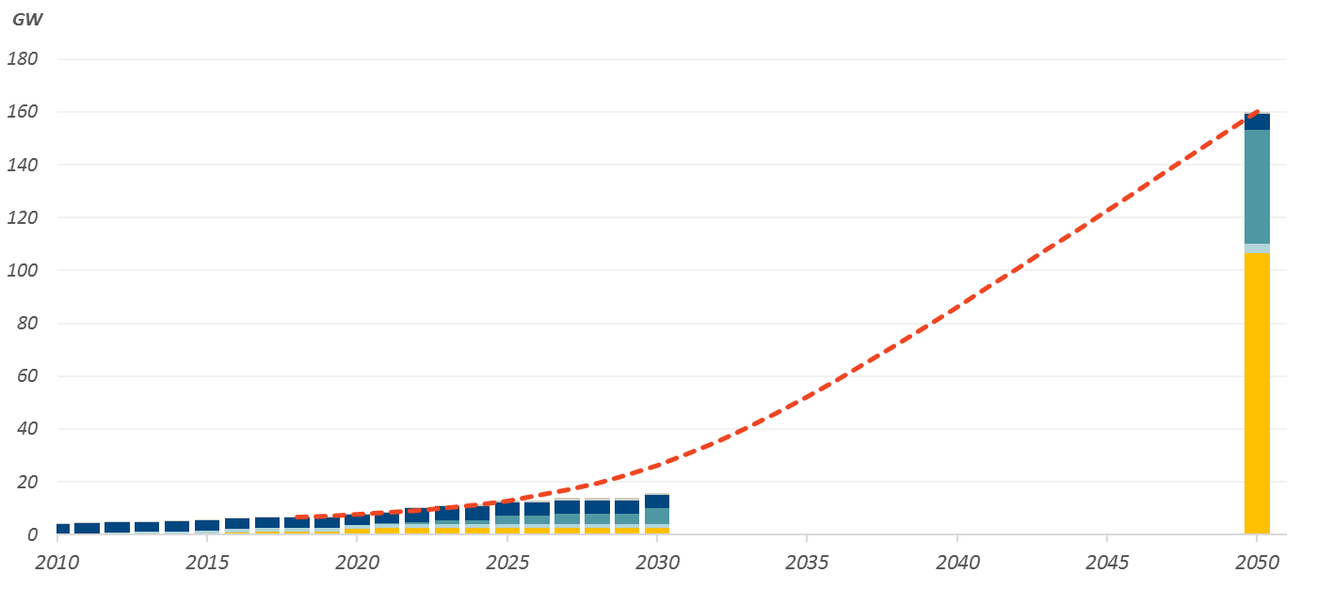
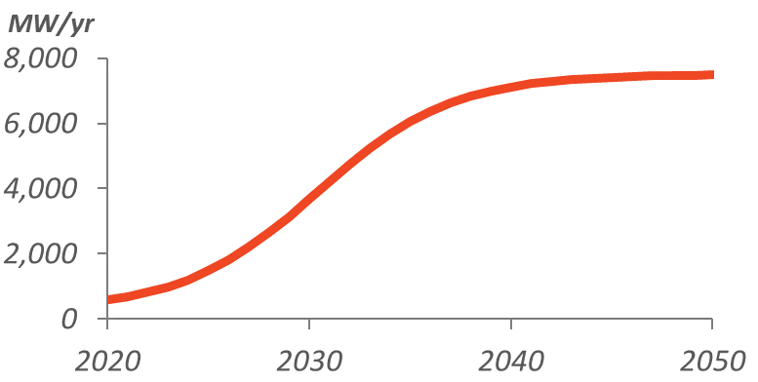
To get there requires significantly accelerating current and currently anticipated deployments.
Cumulative Clean Energy Resources in New England
Required for 80% GHG Reductions
5,100 MW/year (Balanced Portfolio)
2019–2050
Historical
280 MW/year
2010–2018
Currently Planned
830 MW/year
2019–2030
Hydro
Annual Additions
Offshore Wind
Onshore Wind
Cumulative Resources
Solar
Large-Scale Resources: | 3,500 MW/yr
Balanced Portfolio: | 5,100 MW/yr
Local Solar & Storage: | 6,600 MW/yr

Slide 6
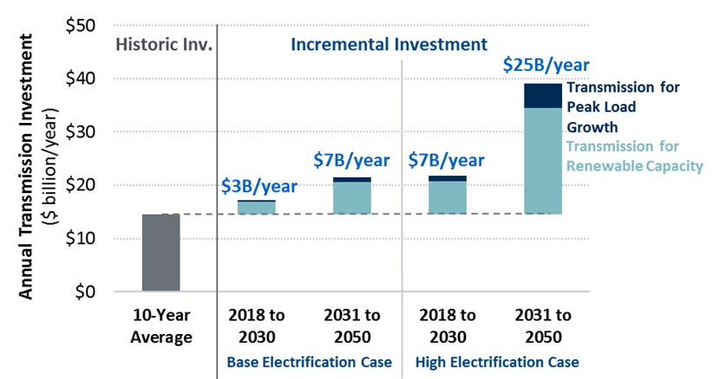
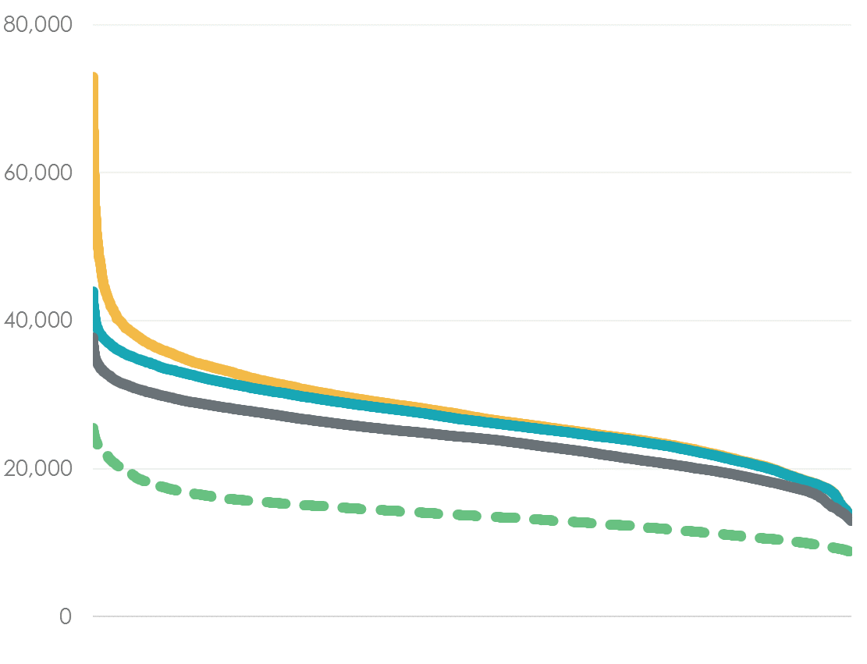
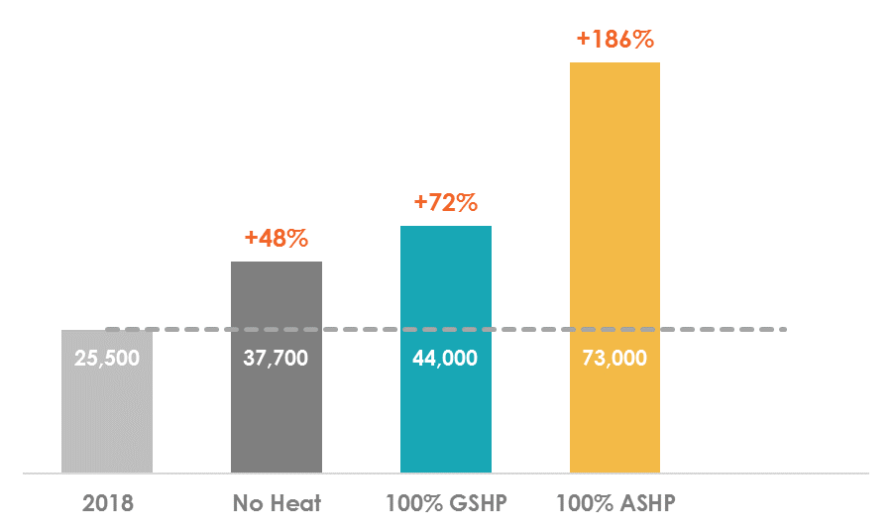
Any/each of these portfolios will have important T&D system implications
Incremental U.S. National
transmission investment
NE Distribution peak impacts of electrification
We estimated a rough doubling of incremental annual national transmission investment) – largely related to connecting RE resources to grid
In New England, interconnecting 40 GW of offshore wind could be a particular challenge
Distribution investments also potentially very significant as local peaks could increase sharply
  ASHPs are particularly impactful
  Shifting to winter peak may help a bit for distribution wires

Slide 7

  Jurgen Weiss
    Principal, Boston
    +1.617.864.7900
    Jurgen.Weiss@brattle.com
Dr. Jurgen Weiss is an energy economist with 25 years of consulting experiences. He specializes in issues broadly motivated by climate change concerns, such as renewable energy, energy efficiency, energy storage, the interaction between electricity, gas, and transportation. He spearheads Brattle’s electrification efforts. He works for electric utilities, NGOs, and government entities in North America, Europe, and the Middle East.
Dr. Weiss holds a Ph.D. in Business Economics from Harvard University, an M.B.A. from Columbia University and a B.A. from the European Partnership of Business Schools.

Slide 8
Backup

Slide 9
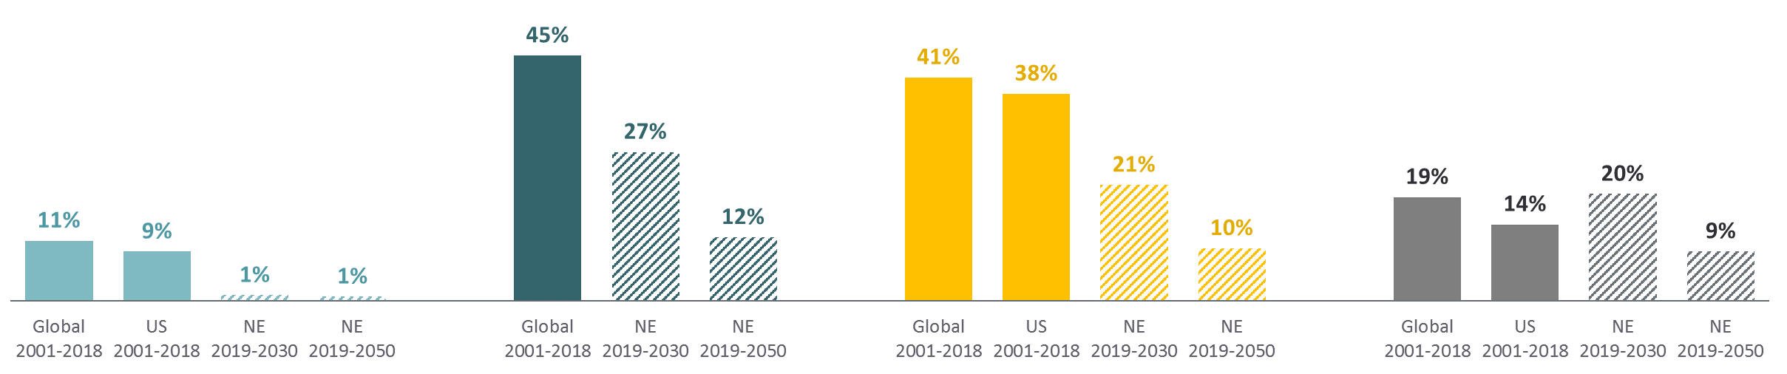

This scale of clean energy additions can be achieved if New England keeps its foot on the accelerator
  Growth rates similar to the growth of global annual renewables deployments over the past 20 years, which have averaged 11% per year for wind, 45% per year for offshore wind and 41% per year for solar PV
  But…
    Also need to scale up related infrastructure (e.g., transmission, distribution, PUC capacity, interconnection processes)
    Achieving the underlying electrification also requires acceleration (e.g., charging infrastructure, heat pump installations)
Growth Rate of Annual Capacity Additions
Onshore Wind
Offshore Wind
Solar PV
Wind and Solar
Historical
Required to meet 2050 GHG goals
Source: IRENA, Renewable Electricity Capacity and Generation Statistics, July 2019. Note: New England (NE) bars represent the needed annual growth in the Balanced Portfolio to achieve 2050 goals.

Slide 10
Side Note: Electrification can be “direct” or “indirect”
“Direct” – use electricity directly
“Indirect” – use electricity to create drop-in fuels
Total electricity demand
Transportation
EVs, ASHPs, GSHPs, induction, microwave, resistance heat
P2G
P2L
Hydrogen via electrolysis
Buildings
Industry
Needed if bio-feed stocks are insufficient/uneconomical or if direct electrification is not possible
Long-distance air travel, shipping,
and freight
High industrial heat or feedstock
Seasonal storage of surplus clean electric generation?
Uses more power than direct due to lower “well to wheels” efficiency

Slide 11
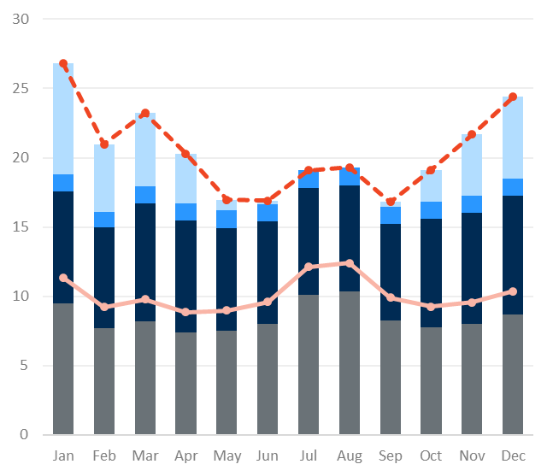
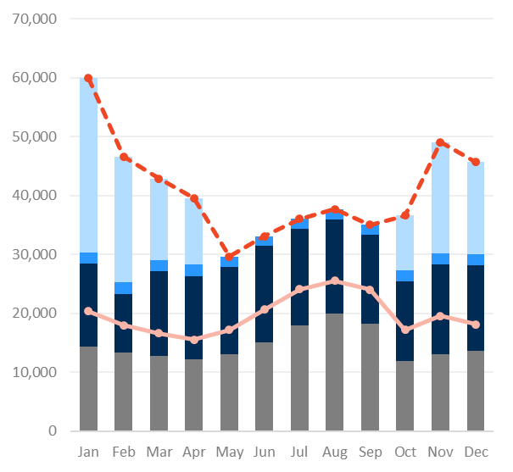
Heating electrification will make demand grow most in the winter, more than doubling peak demand
Monthly Energy (TWh)
Monthly Peak (MW)
TWh
MW
27
2050 Peak Demand
60,000 MW
23
24
2050 Total
21
20
22
Space Heating
19
19
19
2050 Total
17
17
17
Water Heating & Other
Space Heating
Transportation
Water Heating & Other
2018 Total
Transportation
2018 Total
Conventional Demand
2018 Peak Demand
25,600 MW
Conventional Demand
Any clean portfolio of resources will need to meet this new pattern of demand.

Slide 12
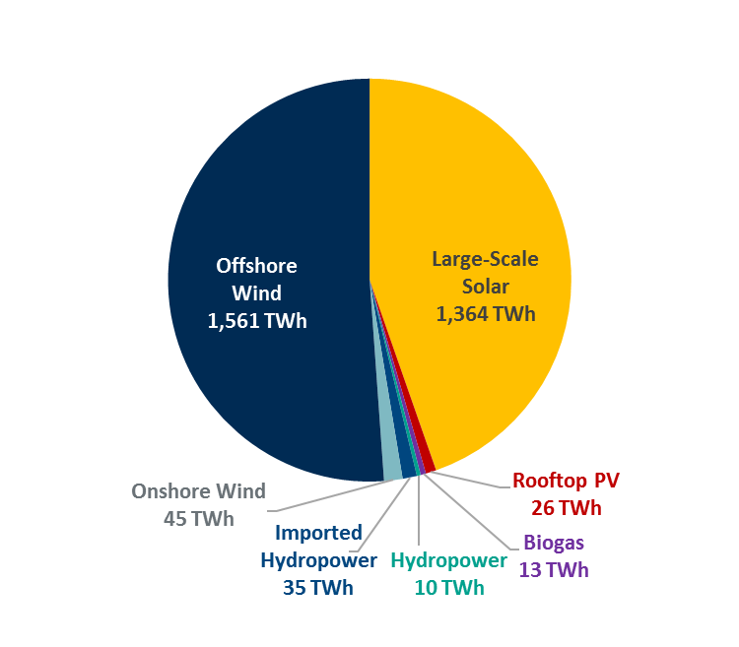
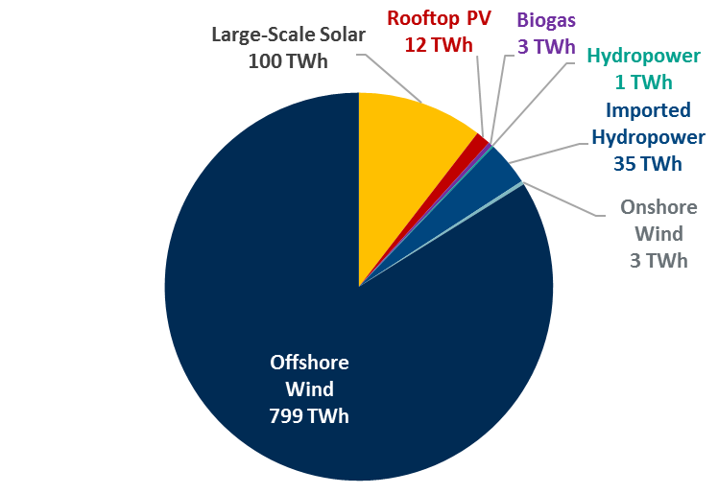
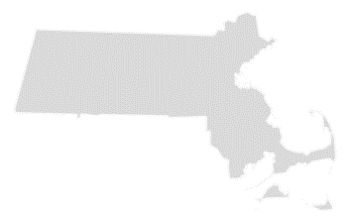
Offshore wind and solar provide the vast majority of potential clean energy resources in New England
Clean Energy Resource Technical Potential
New England
Massachusetts
Total potential:
3,054 TWh
Total potential:
953 TWh
~10% of land/80% of non-forested land
Electricity demand forecast in 2050:
214–286 TWh
Electricity demand forecast in 2050:
95–140 TWh
New England technical potential far exceeds needs
New York also has a significant onshore wind potential

Slide 13
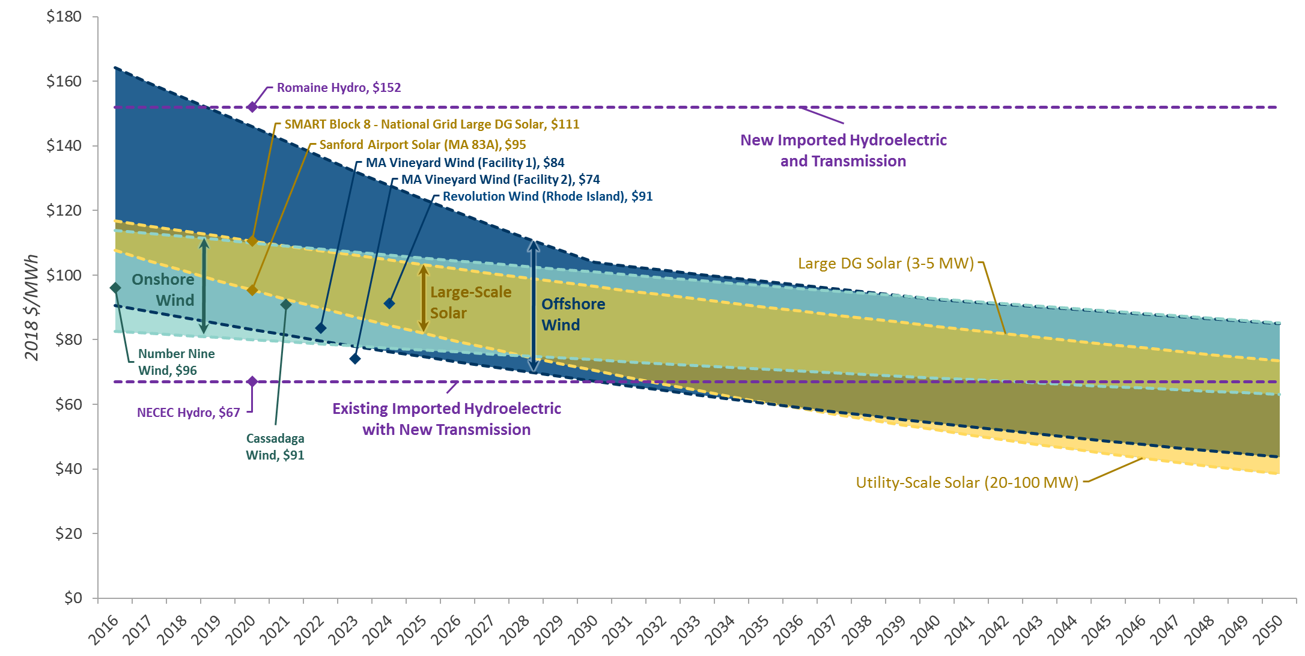
(Clean) costs decline and remain comparable through 2050; supply portfolio choice not mostly based on LCOE
2050 Estimated New England Resource Costs
(No tax credits, includes transmission costs to MA)

Slide 14
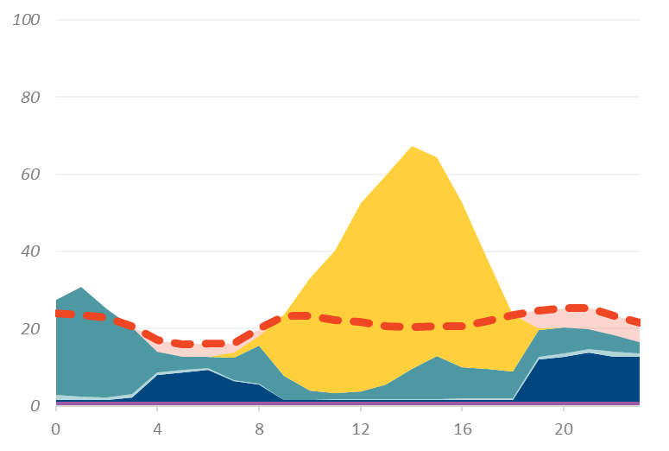
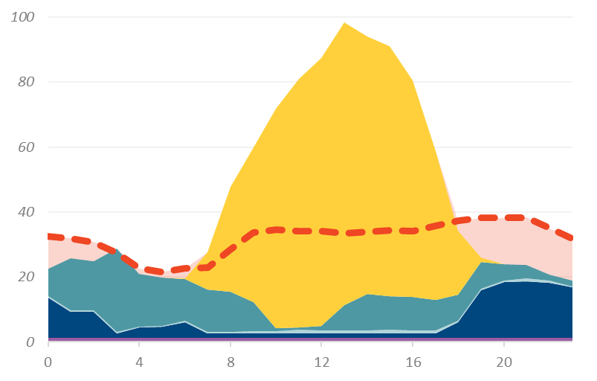
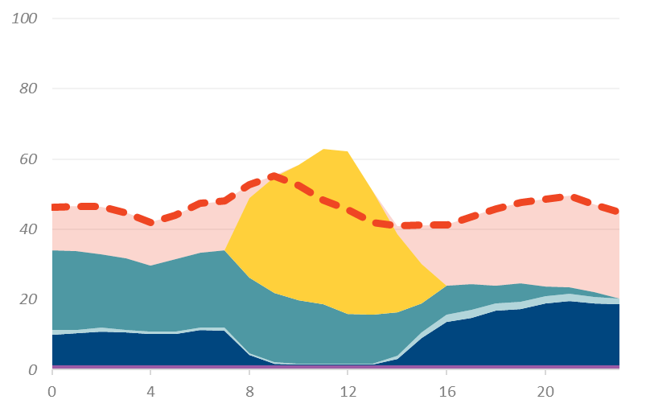
2050 Resource Portfolios
Storage, gas, and hydro will play key roles in balancing system supply and demand
Hourly Electric Sector Load and Supply
Scenario: Balanced Portfolio
Winter
Spring
Insufficient clean generation throughout the day; storage and gas required to meet load
Excess clean generation midday is stored to meet evening and early morning demand
Gas
Load
Storage/Gas
Offshore Wind
Solar
Onshore Wind
Nuclear
Hydro
Summer
Fall
Balancing required between day and night hours using storage
Limited excess midday generation can be stored to meet some hours of deficiency; require gas for remaining supply
Note: The figures show the generation and load profiles during a high demand day of the respective season.

